Slide 1
Construction

Slide 2
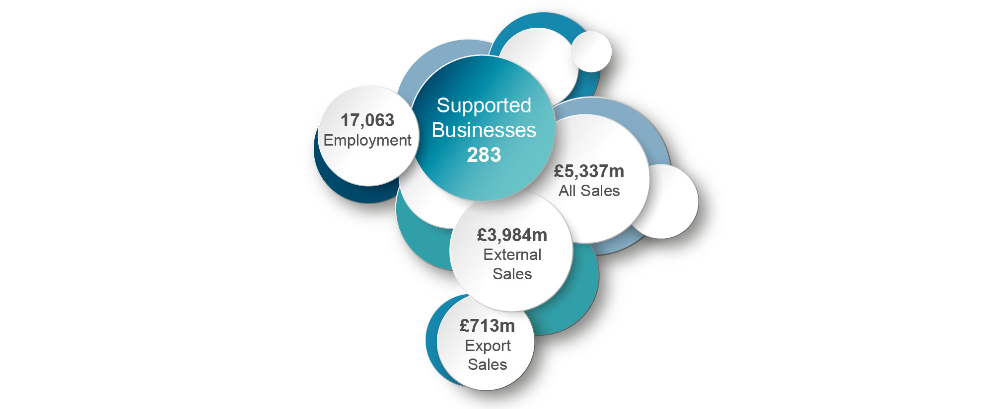
Construction Sector
2022

Slide 3
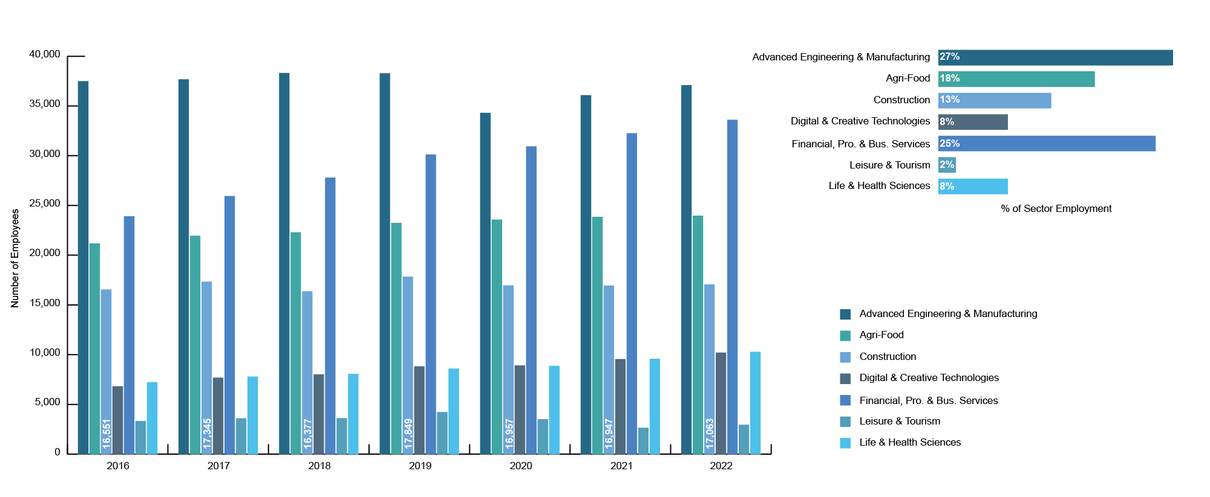
Employment by Sector
2016 - 2022

Slide 4
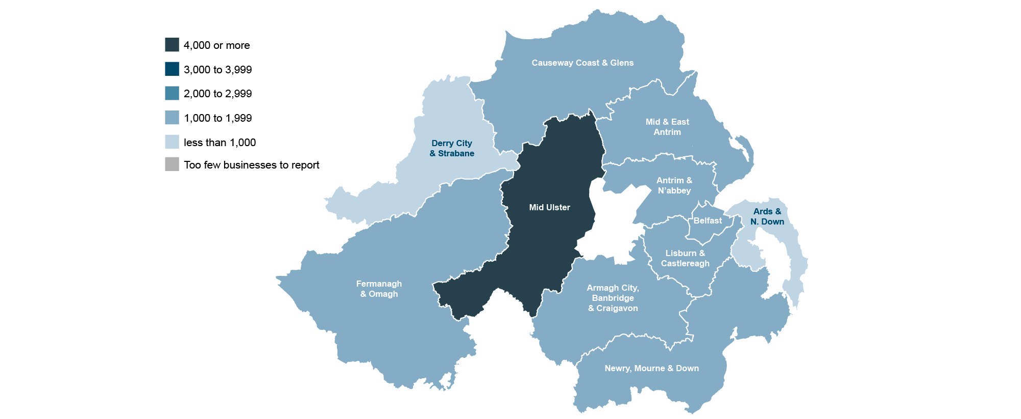
Employment by Location
2022

Slide 5
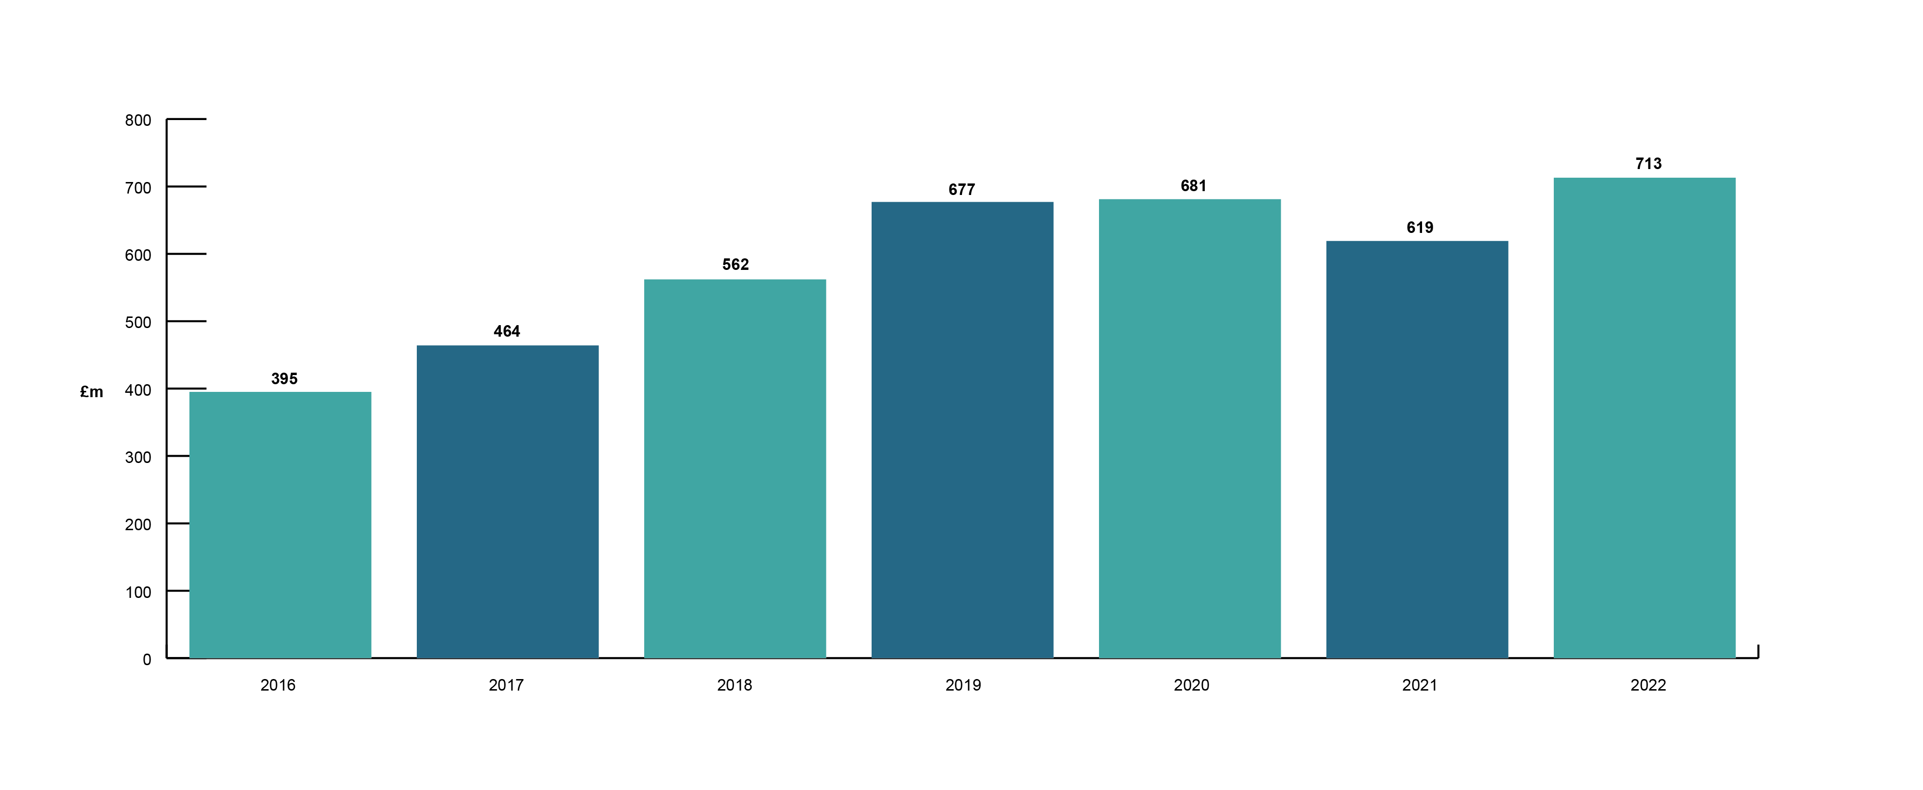
Export Growth
2016 - 2022

Slide 6
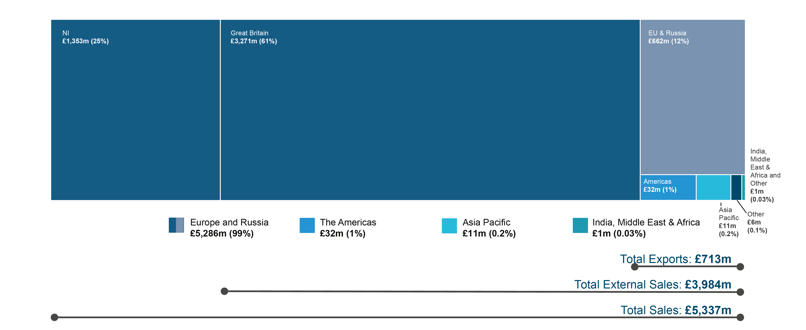
Sales by Market Destination
2022

Slide 7
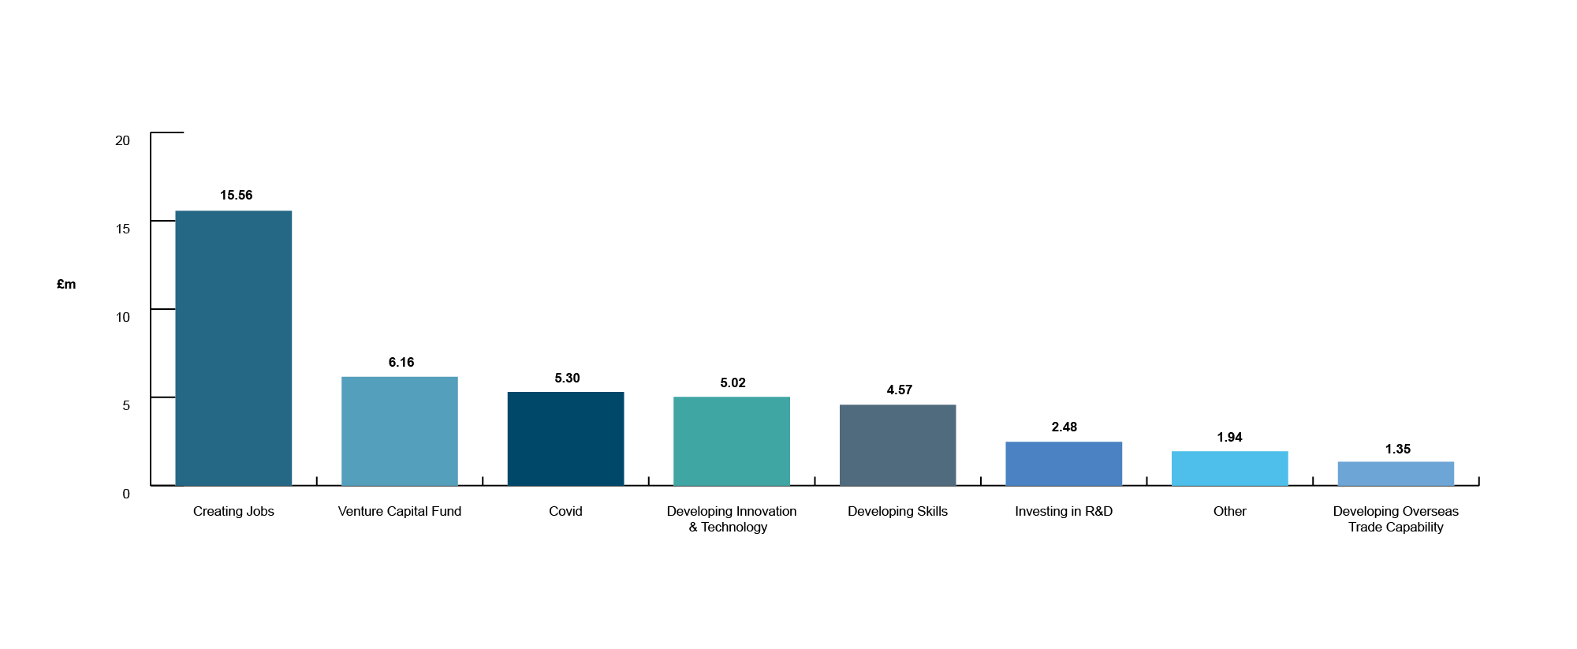
Invest NI Support Offered (£m)
2018-19 to 2022-23

Slide 8
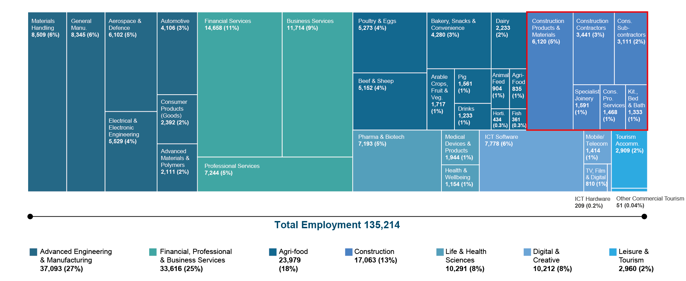
Northern Ireland’s Sector Analysis from KPIs
2022

